Slide 1

Network Function Virtualization (NFV) and the OSI Architecture
GUDIDED BY:
Dr.Jesu Jayarin
PRESENTED BY:
Y.Geetha Reddy(192572053)

Slide 2
INTRODUCTION:
Network Function Virtualization (NFV) is a technology that replaces network hardware with software-based network functions.
It helps reduce cost, improves flexibility, and makes network management easier.
The OSI (Open Systems Interconnection) model is a 7-layer framework that explains how data travels between devices.
Together, NFV and the OSI architecture help build efficient, reliable, and modern computer networks.

Slide 3
What is Network Function Virtualization (NFV)?
Definition
Network Function Virtualization (NFV) is a technology that runs network functions as software on virtual machines instead of dedicated hardware.
It allows network services to be deployed quickly and managed easily.
Examples
Virtual Firewall
Virtual Router
Virtual Load Balancer
Virtual VPN Gateway
Benefits
Reduces hardware cost
Easy deployment
Faster service delivery

Slide 4
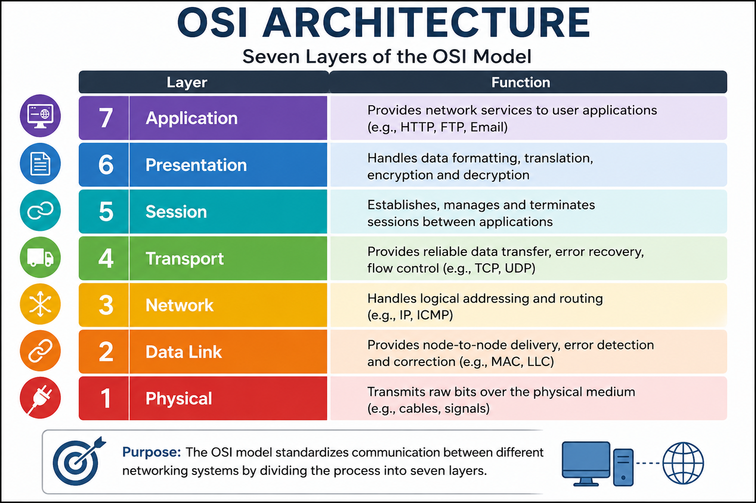
OSI Architecture:

Slide 5
NFV AND THE OSI ARCHITECTURE:
Relationship Between NFV and OSI
NFV virtualizes network functions that operate at different OSI layers.
Common virtualized functions include:
Layer 3: Virtual Router
Layer 3 & 4: Virtual Firewall
Layer 4 & 7: Virtual Load Balancer
Layer 3: Virtual VPN
Advantages
Better resource utilization
Flexible network management
Faster deployment of services
Reduced operational costs

Slide 6
CONCLUSION:
Network Function Virtualization (NFV) makes networking more flexible by replacing hardware with software-based network functions.
The OSI architecture provides a standard framework for communication across networks.
Together, NFV and the OSI model improve network performance, scalability, and efficiency while reducing costs.

Slide 7
THANK YOU!

